Slide 1
Character Design and Features

Slide 2
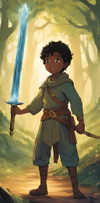
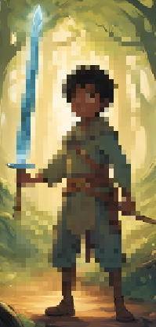
Main character : Tari
This is Tari, the main character the user will play in the multiplication game
Notes:
Tari is the main character that the user will use. This character image will be on the edge when you start the game. This is the base character; it can be customised, which will be shown in the following slides. Character was used with captcha ai

Slide 3
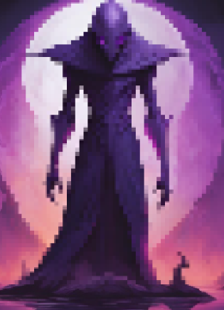
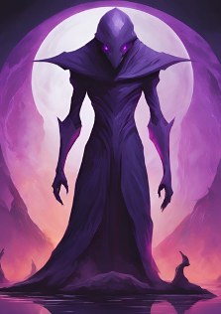
Main and Final Boss: Faceless Void
All missions tari does are crossing bridges or pathways. Only the final mission is where you face the Faceless void
Notes:
The Faceless void is used with Canva AI. The only mission where there is an opposing character as a challenge. The other missions are obstacles such as bridges and what not.

Slide 4
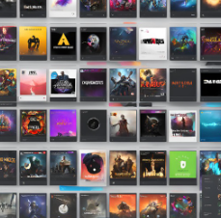
Customisation
With customisation you choose what songs you can pick. The more levels you get passed the more options of music
Notes:
As you increase level in the game you can choose more types of music you want on the section store. This image was used with Canva AI. The music you purchase will be played when you play the game

